Slide 1
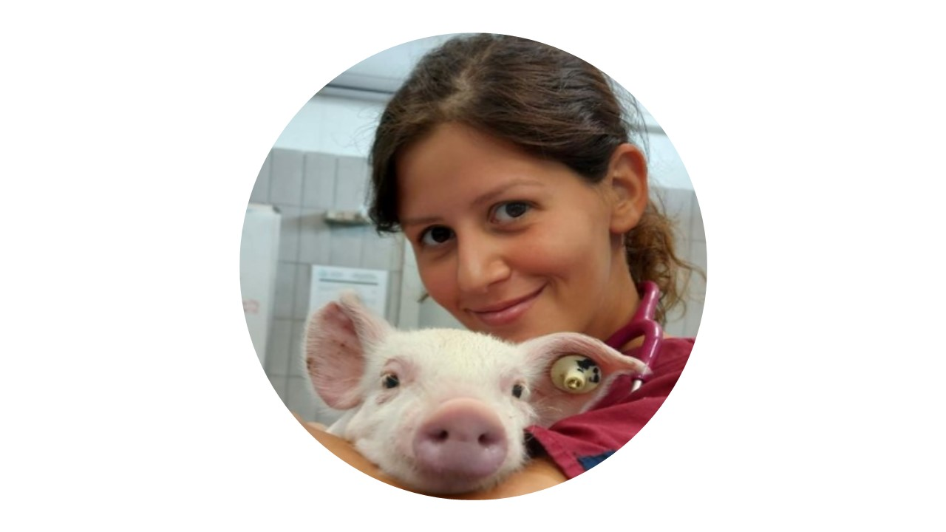



DR.
LAURA FILIPPONE PAVESI
VAS discussion thesis
Phd COURSE in veterinary and animal science
Phd COURSE in veterinary and animal science
Thesis: A prospective cohort study on antimicrobial resistance on dairy cattle: prevalence among pathogens isolated from dairy farms in northern Italy and risk factors associated with antimicrobial resistance spreading
WEB PAGE
JUNE
30
02:00 Pm
ROOM L122

